Slide 1
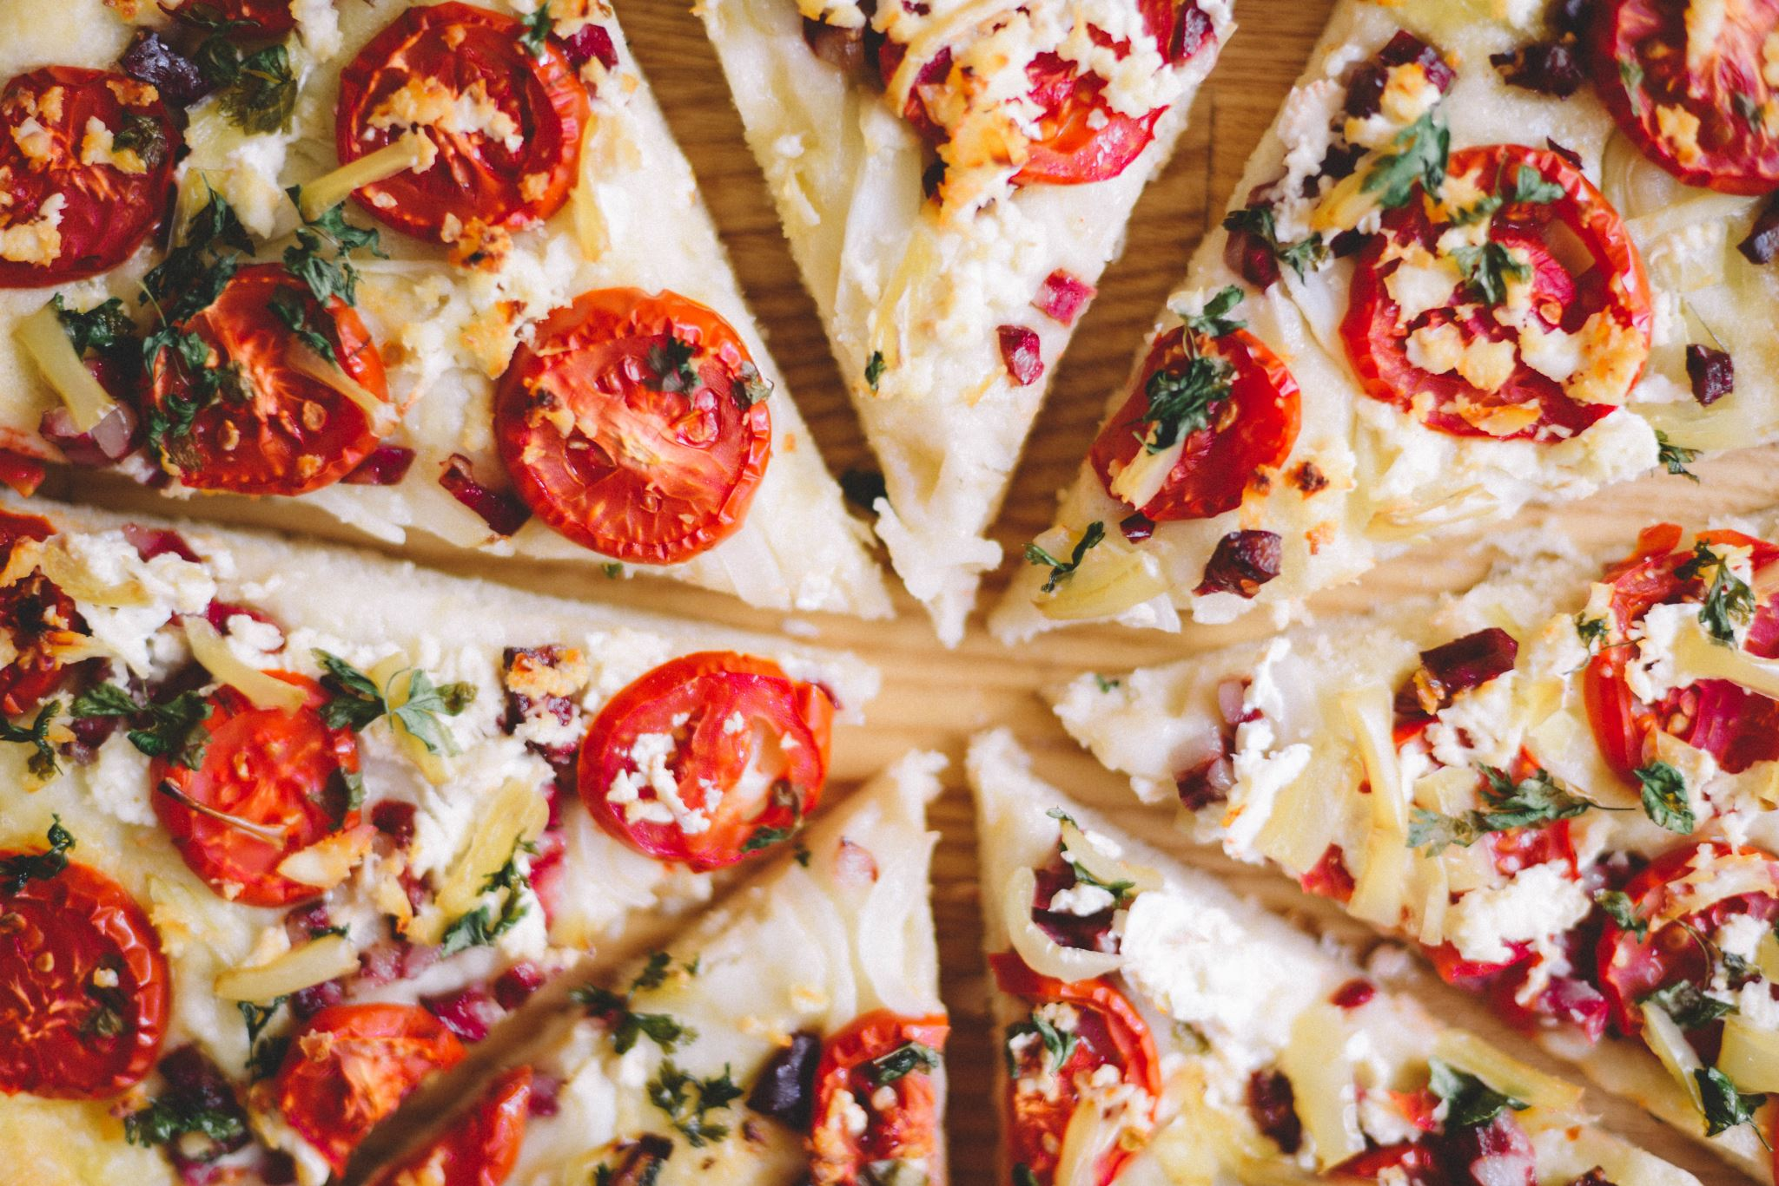
PIZZA SALES USING SQL
BY-SHIVALI JAIN
shivalij094@gmail.com

Slide 2

Bussiness Questions answered
Retrieve the total number of orders placed.
Calculate the total revenue generated from pizza sales.
Identify the highest-priced pizza.
Identify the most common pizza size ordered.
List the top 5 most ordered pizza types along with their quantities.
The total quantity of each pizza category ordered.
Determine the distribution of orders by hour of the day.
Join relevant tables to find the category-wise distribution of pizzas.
Group the orders by date and calculate the average number of pizzas ordered per day.
Determine the top 3 most ordered pizza types based on revenue.
Calculate the percentage contribution of each pizza type to total revenue.
Analyze the cumulative revenue generated over time.
Determine the top 3 most ordered pizza types based on revenue for each pizza category.

Slide 3
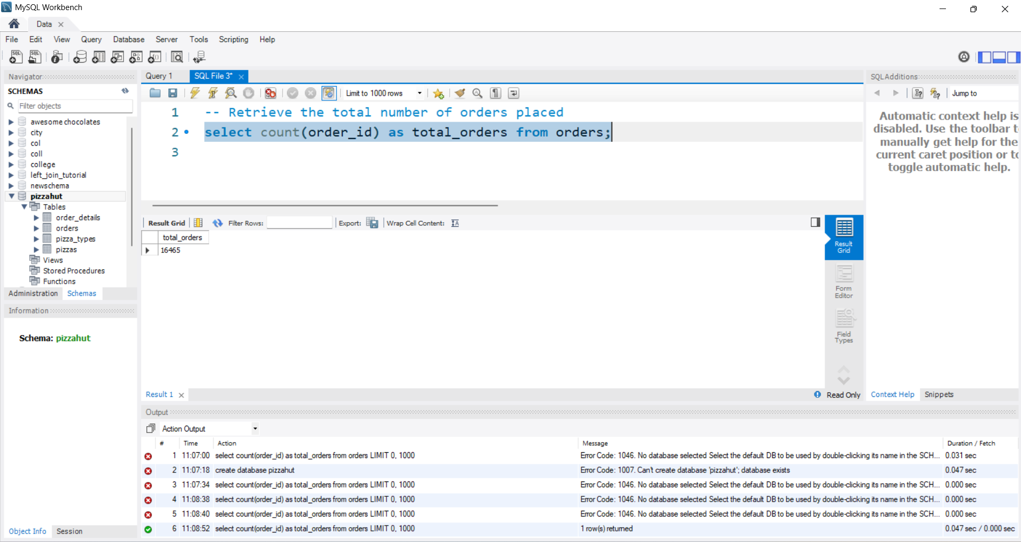
Retrieve the total number of orders placed.
SQL QUERY
OUTPUT
INSIGHT
The total order placed were 16465.

Slide 4
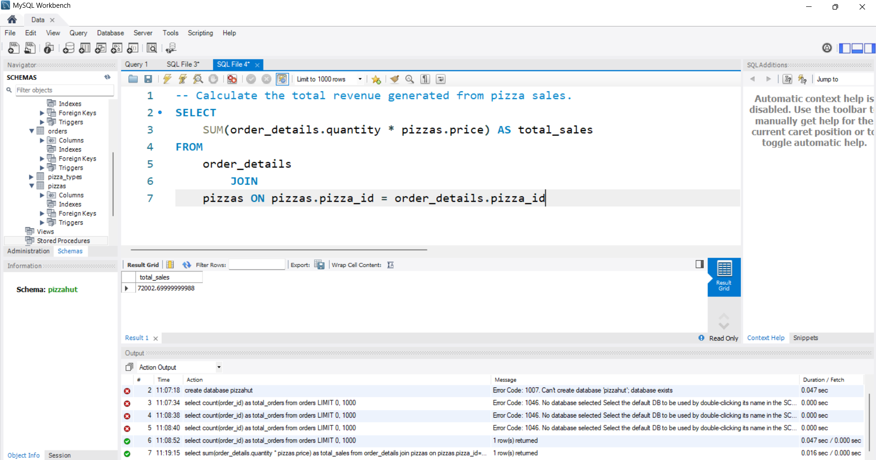
Calculate the total revenue generated from pizza sales.
SQL QUERY
OUTPUT
INSIGHT
The total revenue generated was ~ 72003.

Slide 5
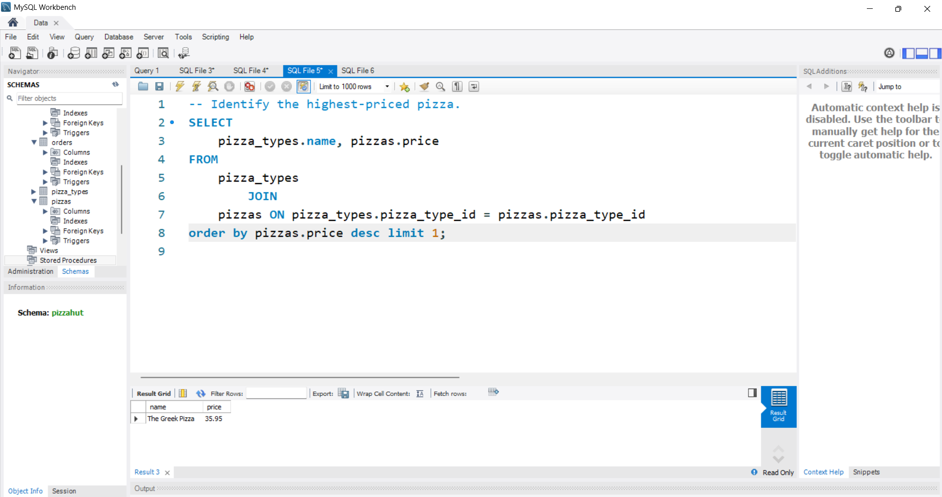
Identify the highest-priced pizza.
SQL QUERY
OUTPUT
INSIGHT
The highest –priced pizza is Greek pizza~$36.

Slide 6
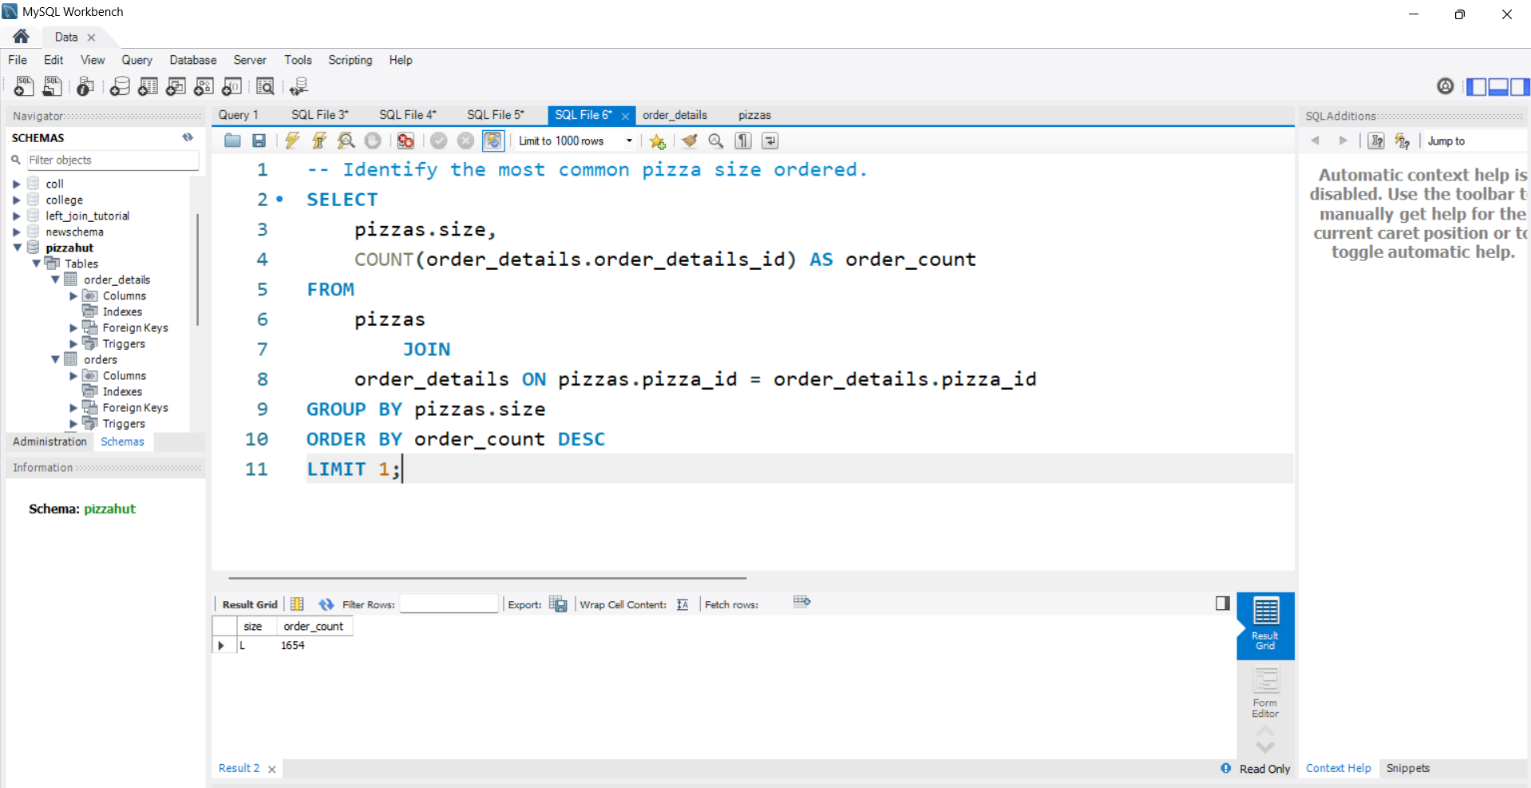
Identify the most common pizza size ordered.
SQL QUERY
OUTPUT
INSIGHT
The most common pizza size ordered is LARGE-1654

Slide 7
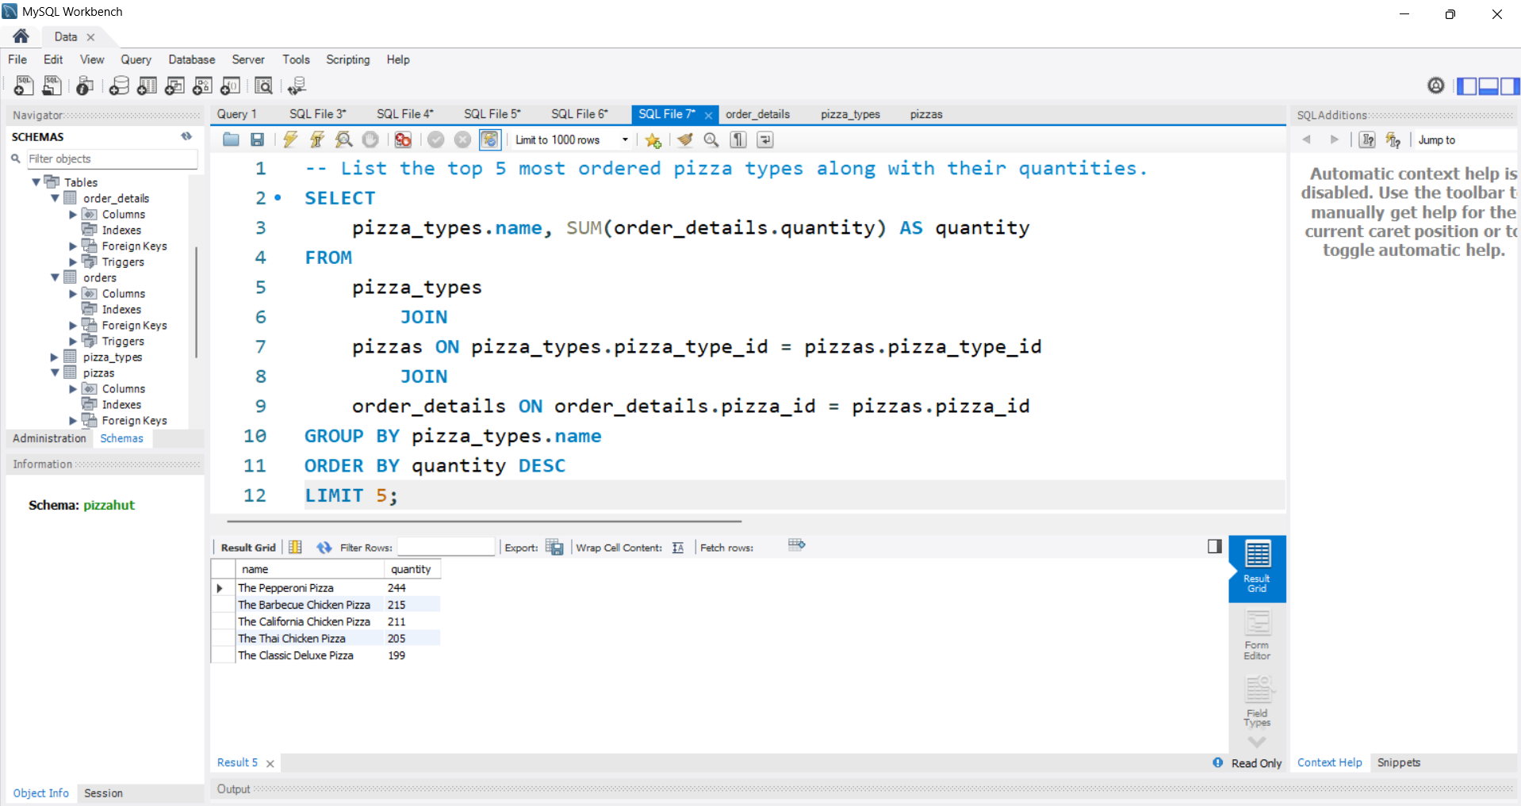
List the top 5 most ordered pizza types along with their quantities.
SQL QUERY
OUTPUT
Pepperoni Pizza | 244
Barbecue Chicken Pizza | 215
California Chicken Pizza | 211
Thai Chicken Pizza | 205
Classic Deluxe Pizza | 199
INSIGHT

Slide 8
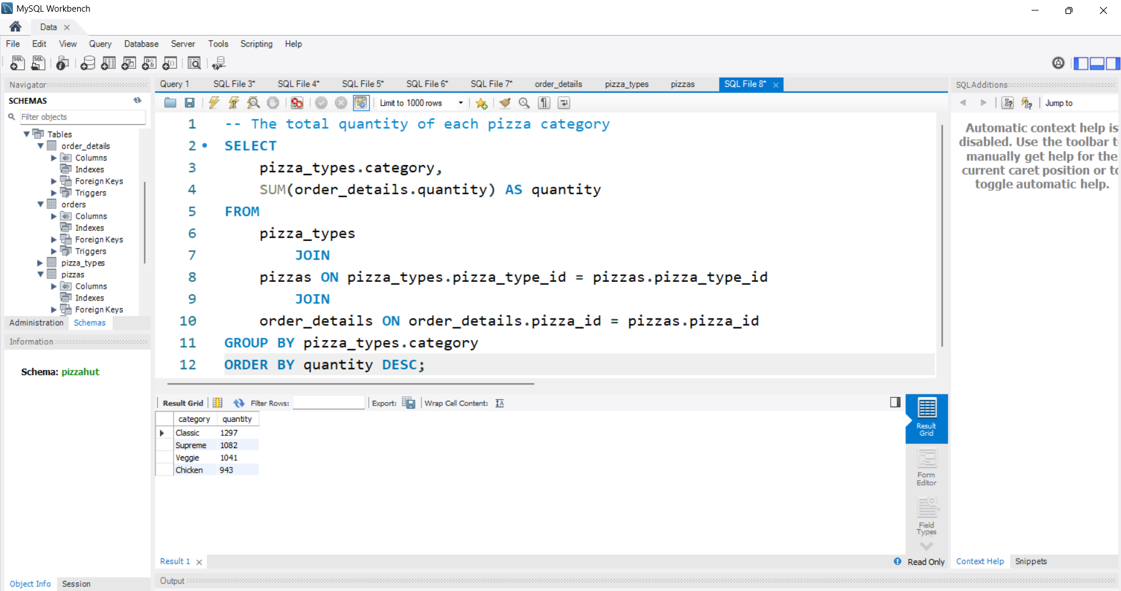
The total quantity of each pizza category ordered.
SQL QUERY
OUTPUT
Classic | 1297
Supreme | 1082
Veggie | 1041
Chicken | 943
INSIGHT

Slide 9
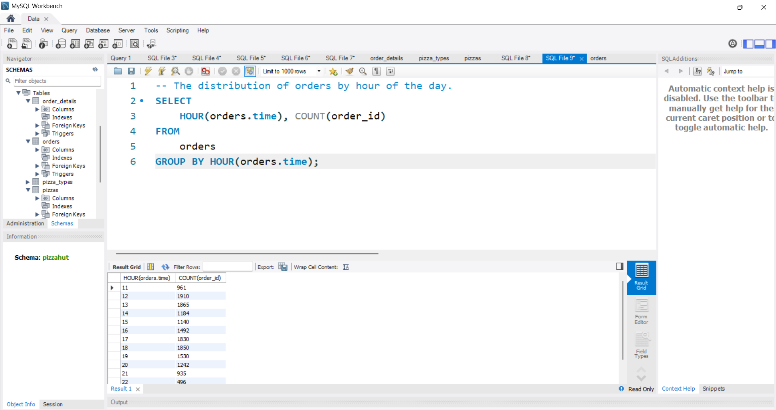
Determine the distribution of orders by hour of the day.
SQL QUERY
OUTPUT

Slide 10
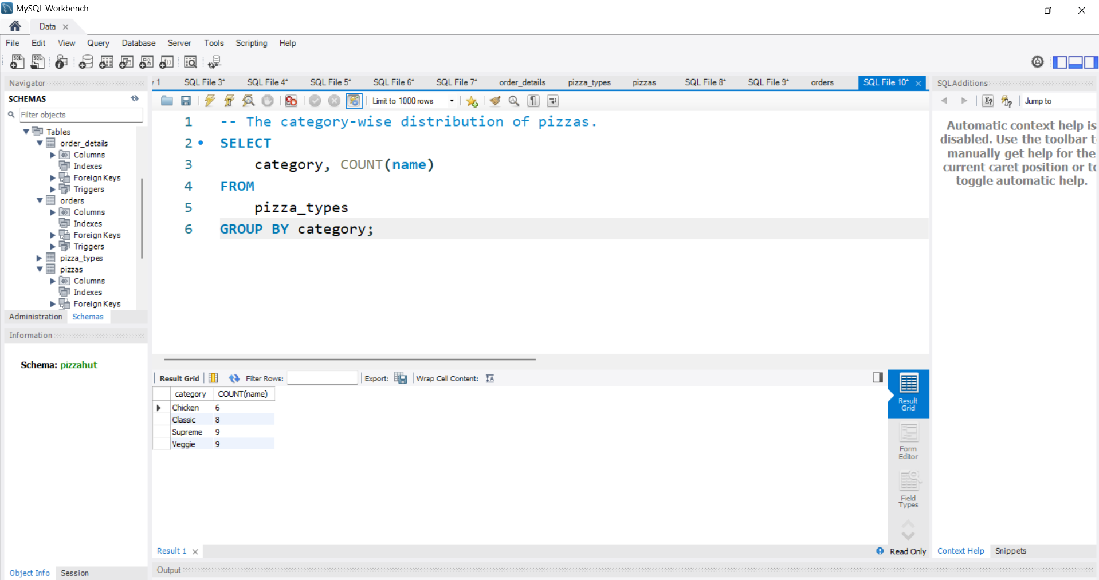
Join relevant tables to find the category-wise distribution of pizzas.
SQL QUERY
OUTPUT
Classic | 6
Supreme | 8
Veggie | 9
Chicken | 9
INSIGHT

Slide 11
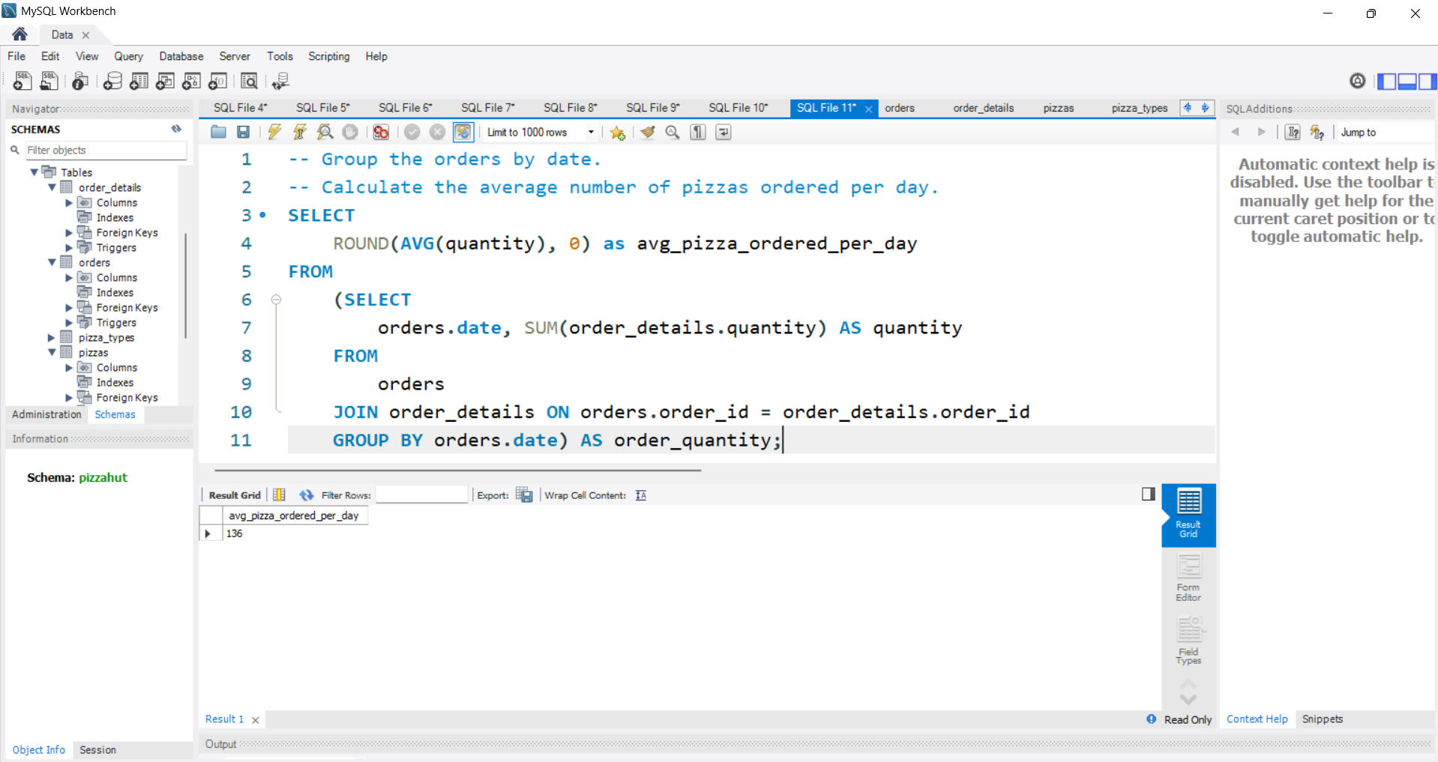
Group the orders by date and calculate the average number of pizzas ordered per day.
SQL QUERY
OUTPUT
INSIGHT
Average number of pizzas ordered per day =136

Slide 12
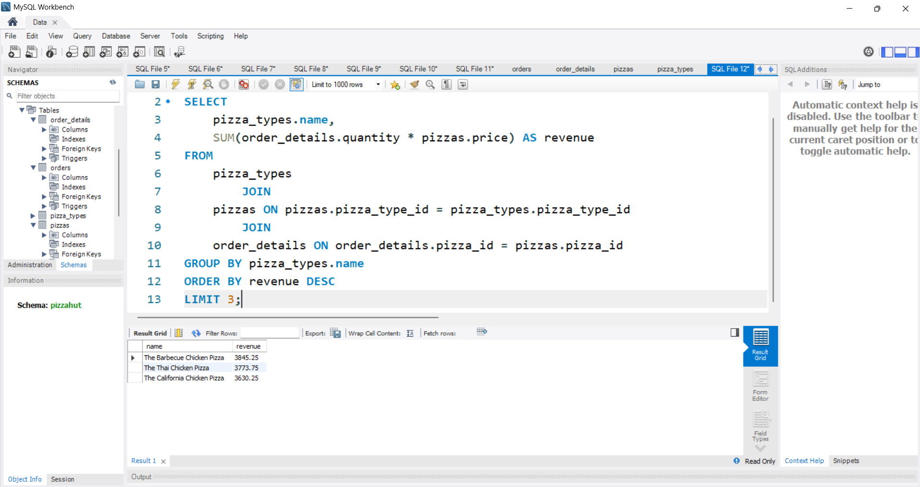
Determine the top 3 most ordered pizza types based on revenue.
SQL QUERY
OUTPUT
Barbeque Chicken Pizza | 3845
Thai Chicken Pizza | 3774
California Chicken Pizza | 3630
INSIGHT

Slide 13
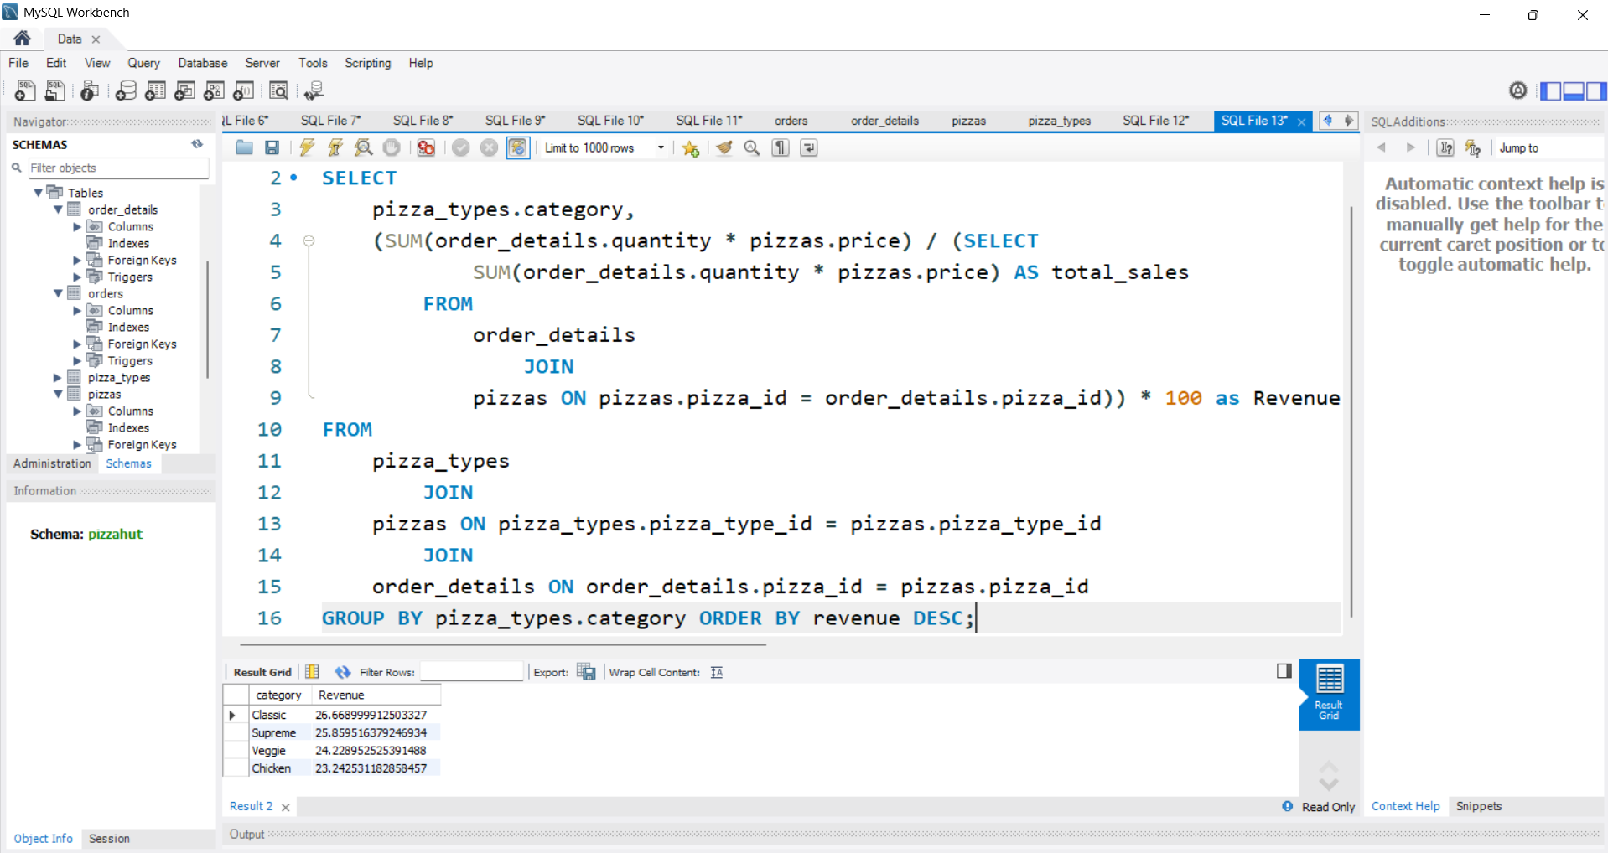
Calculate the percentage contribution of each pizza type to total revenue.
SQL QUERY
OUTPUT
Classic | 27%
Supreme | 26%
Veggie | 24%
Chicken | 23%
INSIGHT

Slide 14
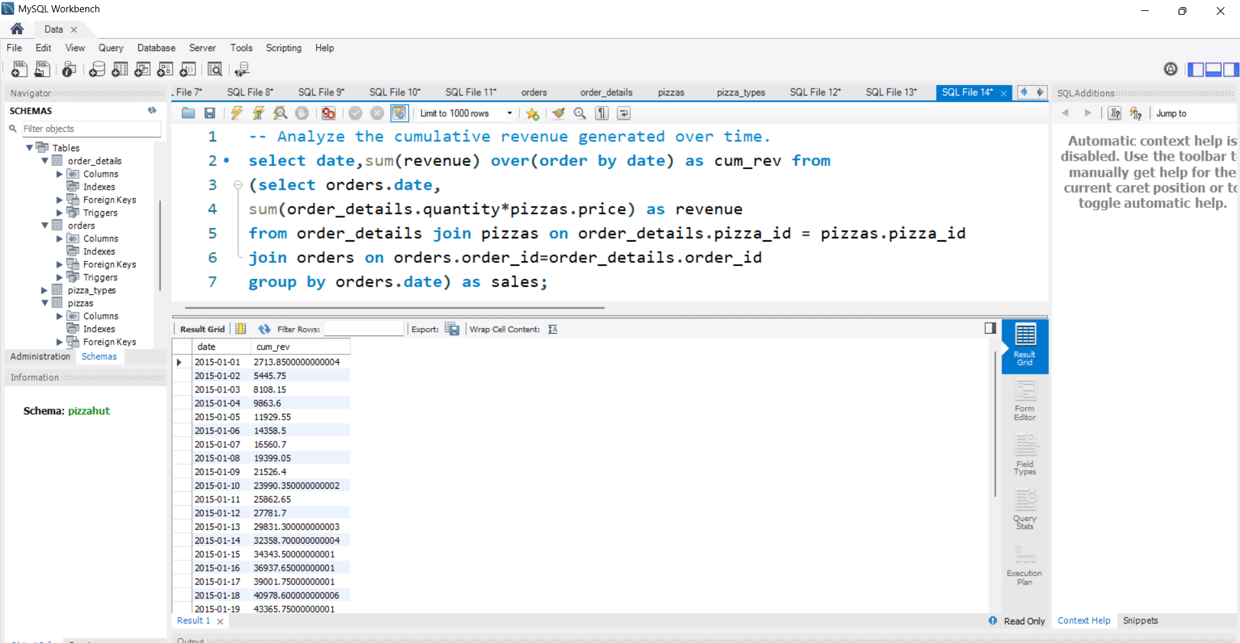
Analyze the cumulative revenue generated over time.
SQL QUERY
OUTPUT

Slide 15
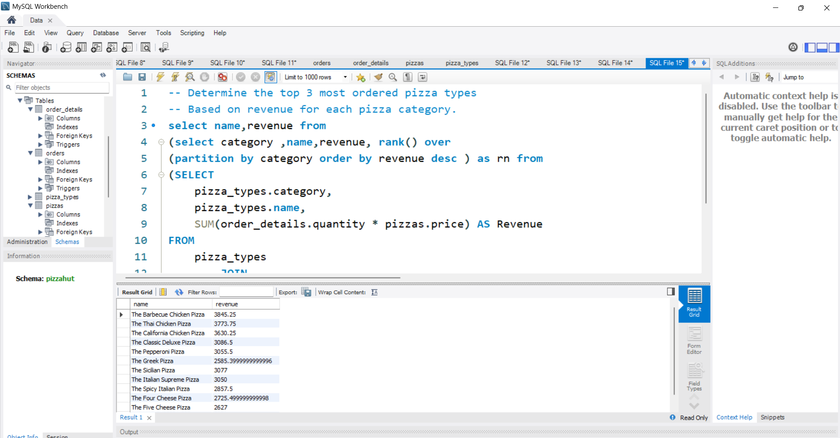
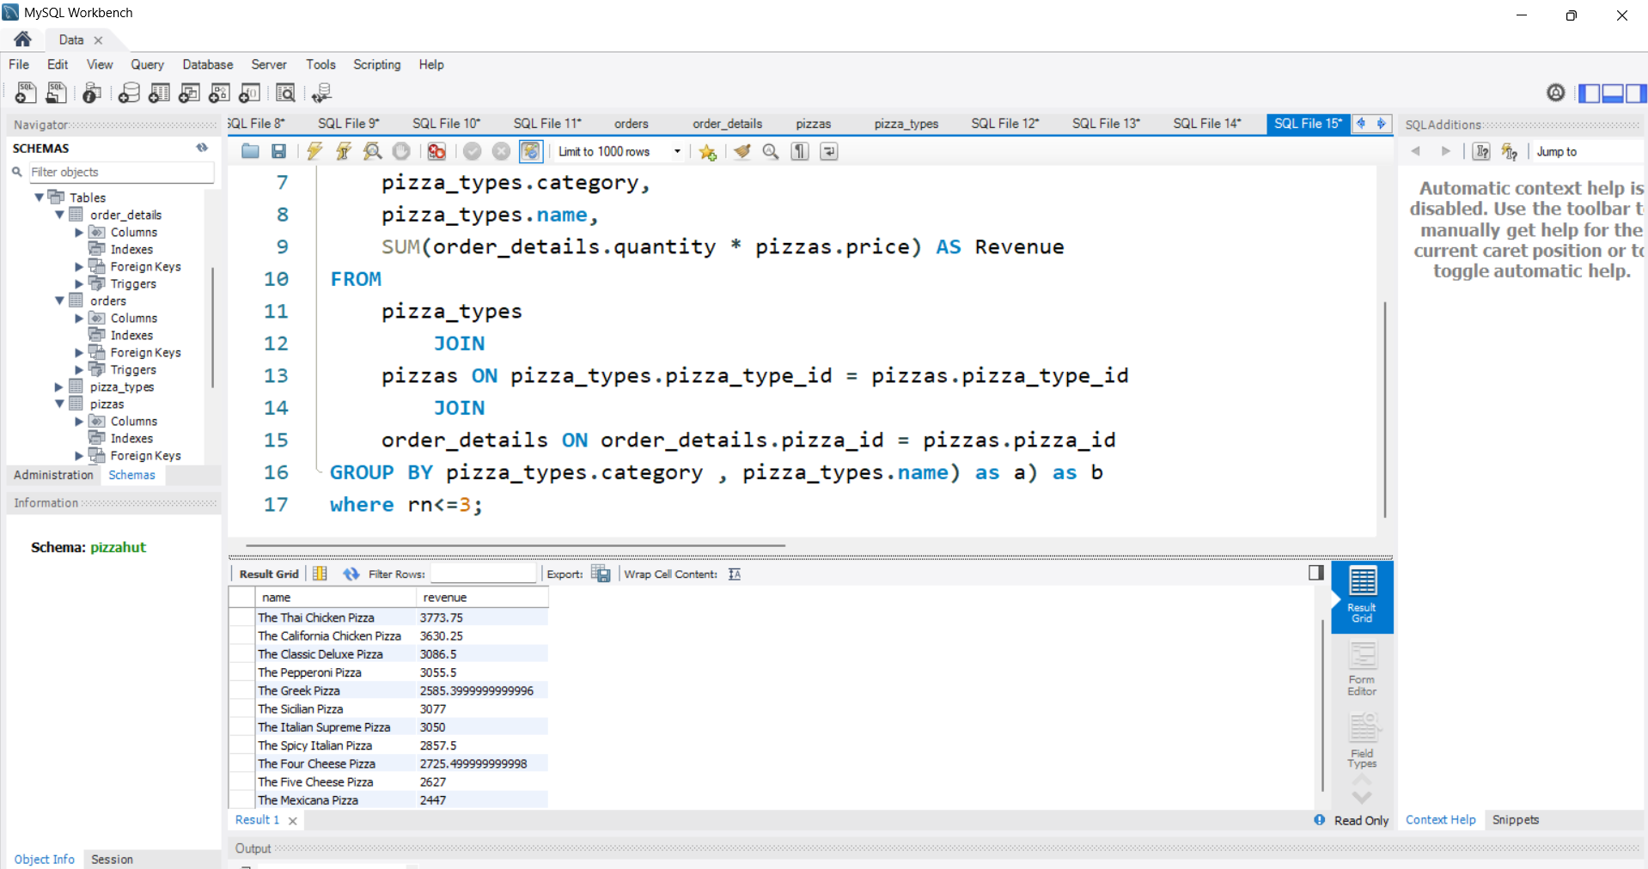
Determine the top 3 most ordered pizza types based on revenue for each pizza category.
SQL QUERY
OUTPUT

Slide 16
THANK YOU

